Slide 1
Team C#
Christian Traxler, Rene Levesque, Martin Cooper, Thomas Oliver

Slide 2
Design Process
Using the competition package, our team organized all of the relevant information that may be used in our solution.
We then individually brainstormed several different methods to calculate infectivity for a day.
We then compared our solutions and chose the most optimal design that could be implemented within the time constraints.
We then began working on the solution by tasking different members with different roles.
Some tasks included I/O, data structure implementation, and algorithms.
Each task was thoroughly tested independently before integration to isolate bugs.
Once the design reached a completed state we focused on testing the application to minimize errors in our calculations.

Slide 3
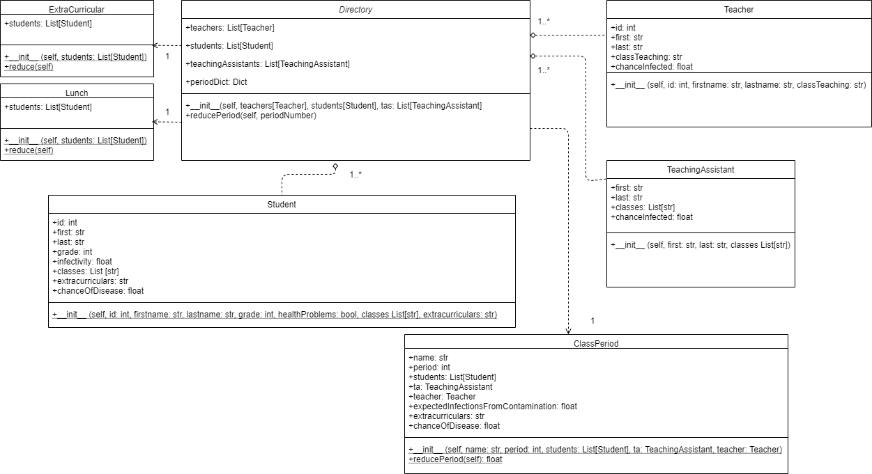

Slide 4
Design Justification
Biggest design choice was to represent as probabilities rather than selecting random people to infect
Allows for deterministic results and helps others to not misinterpret the data
Values:
Contamination Factor: 0.1
R(naught) = 3.0/5.0
Extracurricular Spacing Factor: 2.0
Teacher - Student Multiplier: 0.9
TA - Student Multiplier: 1.1
Teacher - TA Multiplier

Slide 5
Design Critique
More in depth analysis of transmission via surfaces and transmission via contact.
Attempted to create a UI (see next slide) which would allow for easy to use input of a file and output of the results.
Due to time constraints and bugs within the UI we could not complete this so we opted for a simpler console input/output.
Some of our classes our similar so we could have combined them or made a parent class.

Slide 6
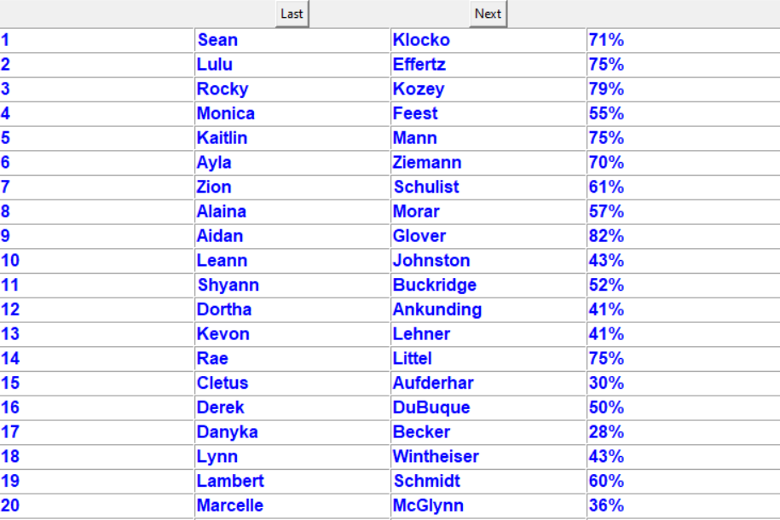

Slide 7
Benefits and Principles of the Solution
Object oriented design
Broke solutions into smaller subproblems(periods, lunch and extracurriculars)

Slide 8
Algorithm Design
Create a list of classes by period (Philosophy, Math, etc…)
Assign students, TAs and teachers to classes
Create ‘var’ of number of people students infect
Go through each student add 3/5 x ‘chance infected’ for each student.
Create ‘var’ of number of people teacher infects
Add 3/5 x chance teacher has to be infected
Do the same as teacher for TA

Slide 9
Algorithm Design continued
Go through student array:
Increase their chance by:
( #students infected/#students + #teacher/#students *teacher_student_multiplier + #ta infects/#students * TA_student Multiplier) * infectivity
We created alternate versions of this algorithm for lunch and extracurriculars

Slide 10
Development
We broke up the work between group members
Thomas worked on file I/O, converting .xlsx data to the classes we designed
Martin/Rene worked on designing classes
Martin worked on the calculation of the spread due to normal classes and from spread due to contaminated surfaces
Rene worked on calculating the spread due to extracurricular activities
Christian worked on determining constants, calculate percent of infection and the UI which was not completed in time so we went with our command line solution.

Slide 11
Potential Stakeholders
School Officials
Could use information to alter classes to limit further spread
Health Officials
Could use information to track the potential spread outside the school to prevent others from outside of the school from getting the virus
Parents
Might want to know what chance their child has of being a zombie

Slide 12
References
Used openpyxl in solution: https://openpyxl.readthedocs.io/en/stable/
UML creation: https://www.diagrams.net/

